Slide 1
Photo-Scan-Summary
By Shraddha Zingade

Slide 2
Photo-Scan-Summary Details
Name: Shraddha Zingade
Repository: https://github.com/Shraddhaz/Photo-Scan-Summary
Project Name: Photo-Scan-Summary
License: Copyright © MIT License
Contact Information: shraddha@pdx.edu

Slide 3
Traditional Summarizing Methods
Read-Note-Summarize
Every time we want to summarize something, we use the traditional approach of reading, understanding and then summarizing it. That’s fine if you have 2 days to go through 5 research papers.
But what if you have handwritten papers to through
and instead of 5, this time there are 10 research papers.
Excessive right ?
Summary from huge texts but not from images
There are a lot of text summarizing softwares found online that summarize your data.
What if you have handwritten copies of data ?
Or a 500 pages of book ?

Slide 4
Photo-Scan-Summary
Photo-Scan-Summary:
Extracts the text with in an image.
Gives you the summary of that image.
Description:
Photo-Scan-Summary extracts the text within an image, and provides its summary in an efficient manner for ease of understanding, that is mainly done by reducing text to its most important sentences. It also supports a broad range of languages, along with language identification.

Slide 5
Application Technical Details
Web Technologies used:
Front-End: HTML/CSS/Bootstrap
Back-End: Node.js/Express
API used:
Google vision API
SMMRY API

Slide 6
Success and Failures
Success:
Successfully designed and developed a web application with almost 4-5 web technologies.
Failures:
Building a complete responsive website (Angular for front-end)
Major problem faced:
Sending data from Node.js server back to HTML file as they are on different ports.
Solution:
Mustache module in Express.

Slide 7
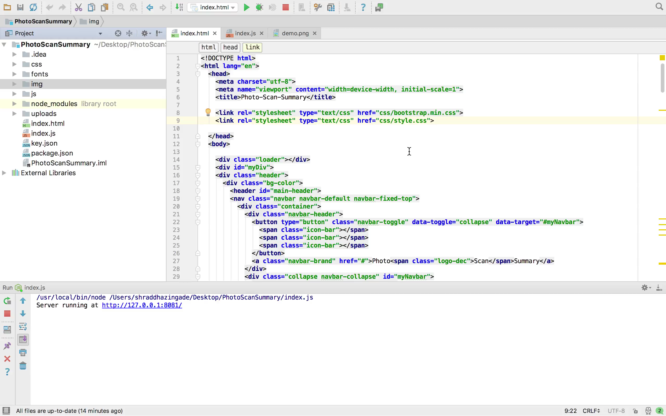
Demo

Slide 8
Application users
Students
Researchers
Academicians
Instead of going through multiple images of handwritten/web notes, the user can just upload the images on the web application and study from the summary.
If there are time constraints, using the application seems like a very good idea to me.

Slide 9
Future Scope
Hosting the web-application live
Deploying this web application on a live system by hosting it on a cloud platform like AWS, Heroku or Google Cloud. This makes the web application more accessible and easy to use.
Multiple images simultaneously
Currently, the software can take one image and summarize it. If the user could input multiple images at a time, it would be easier to use.
Number of lines for Summary
The number of lines that the user can get is three right now. But depending on user’s input on how many lines of summary he needs, the application should give the output.

Slide 10
THANK YOU!

